Slide 1


MAMC01803 Analytics for Managers
Week 5 (Session 2): Predictive Analytics (Regression)

Slide 2
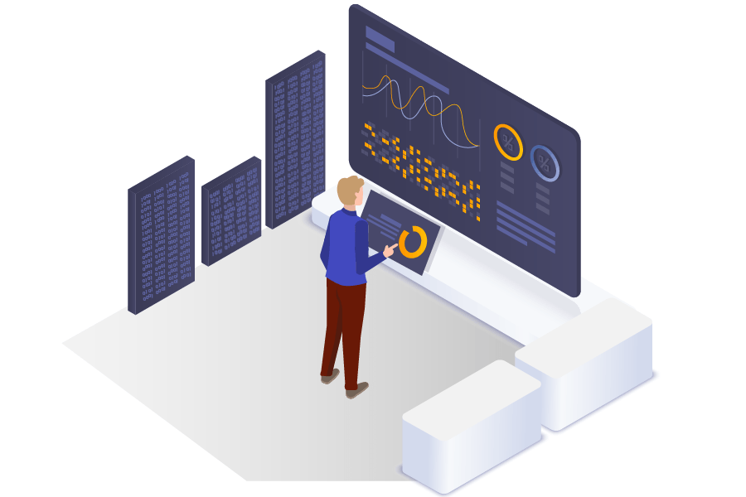
In this lecture:
Topic 1: Predictive analytics (Forecast sheet)
Topic 2: Predictive analytics (Linear Regression)

Slide 3
Forecast sheet on Excel
The Forecast Sheet in Excel is used to create predictions based on historical data using time series forecasting.
You can use this after moving average.

Slide 4
How to Use the Forecast Sheet in Excel?
Select Your Data: Ensure your data has dates (or time periods) in one column and values in another.
Go to the "Data" Tab → Click "Forecast Sheet."
Choose Forecast Type: Line Chart (for trends).
Set Forecast Period & Options: Choose how far into the future to predict.
Click "Create" to generate the forecast.

Slide 5
Simple Linear Regression
A simple linear regression is a method to predict if one variable influences another variable, using a straight line.
In linear regression, each observation consists of two values: One value is for the dependent variable (Y) and one value is for the independent variable (X).
In this simple model, a straight line tells us the relationship between the dependent variable and the independent variable.

Slide 6
Simple Linear Regression
A regression line can show a positive linear relationship, a negative linear relationship, or no relationship.
1) Positive relationship: As one variable increases, the other variable also increases.
2) No relationship: There is no clear pattern or association between the two variables.
3) Negative relationship: As one variable increases, the other variable decreases.
AM811001 20-AIC-05 Week 3 Session 1

Slide 7
In class task:
1. Download the dataset “Regression Analysis- Umbrella Company” from teams-> files-> class activities (week 5 session 2)
2. Conduct linear regression in Excel

Slide 8
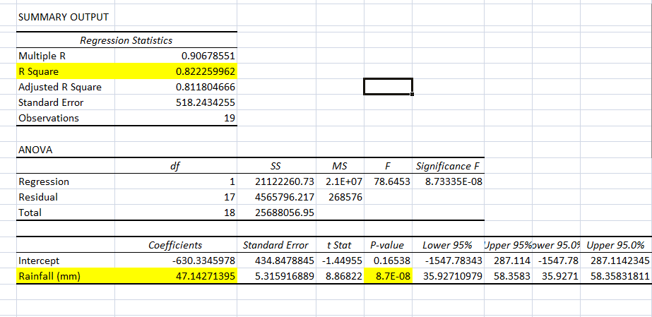
Simple Linear Regression (association)
AM811001 20-AIC-05 Week 3 Session 1

Slide 9
Simple Linear Regression (association)
R Square: What % of the dependent variable can be explained by the independent variable. E.g. If r square is 80%, then 80% of the dependent variable (umbrella sales) is due to the independent variable (rainfall). The remaining 20% is due to other factors such as promotions, advertising etc.
Independent variable (rainfall) coefficient: for every increase in the independent variable, that is how much the dependent variable increases by. E.g. For every mm of rainfall, the umbrella company sells around 47 umbrellas.
P value for the independent variable (rainfall): if it is less than or equal to 0.05, there is a statistically significant relationship between the 2 variables (umbrella sales and rainfall).
AM811001 20-AIC-05 Week 3 Session 1

Slide 10
Simple Linear Regression (association)
AM811001 20-AIC-05 Week 3 Session 1

Slide 11
Simple Linear Regression (prediction)
Formula for predicting (sales): Y=mX+b
Where:
Y = The thing we are predicting (sales).
X = The factor we use to predict (rainfall mm).
m = Slope (how much does the dependent variable (umbrella sales) change by when independent variable increases(rainfall)). This value is given to us after we perform regression on excel.
b = Intercept (what is the dependent variable value (umbrella sales) when independent variable (rainfall) = 0). This value is given to us after we perform regression on excel.
AM811001 20-AIC-05 Week 3 Session 1

Slide 12
Simple Linear Regression (prediction)
AM811001 20-AIC-05 Week 3 Session 1

Slide 13
Example: predicting umbrella sales from rainfall
How much will the umbrella sales be if rainfall is at 50mm?
Formula: Y=mX+b
Equation from regression: y = 47.143x - 630.33
Umbrella sales = 47.143 * 50 – 630.33 = 1727 approx.
If 1 variable is categorical: multiple linear regression (need to convert categorical variables into codes. E.g. gender male = 1 and female = 0).
Decision trees and random forests: can be used to predict both numerical and categorical data.

Slide 14
Recap: analytics techniques
Descriptive analytics:
Used to summarize and visualize data to find patterns & trends.
Box plots, pivot table, column graph, bar graph, descriptive statistics (mean and std deviation).

Slide 15
Recap: analytics techniques
Diagnostic analytics:
Used to find relationships & causes in data.
T tests: Compare two groups (1 numerical and 1 categorical variable across both groups) to check if they are significantly different to each other (p value should be less than or equal to 0.05). Example: sales of item A vs sales of item B.
ANOVA: Compare three or more groups (1 numerical and 1 categorical variable across all groups) to check if they are significantly different to each other (p value should be less than or equal to 0.05). Example: sales of item A vs sales of item B vs sales of item C.

Slide 16
Recap: analytics techniques
Diagnostic analytics:
Used to find relationships & causes in data.
Chi Square Test: Check relationships between categorical variables. Example: gender and types of products purchased. Create 2 tables for observed and expected values and generate chi square test p value. If p value is less than or equal to 0.05, there is a statistically significant relationship between both the categorical variables.
Correlation & Regression: Measure strength, direction and significance of relationships between one dependent and one independent numerical variables. Example: checking if ad spending affects sales. Correlation coefficient (r) from correlation tells you the strength and direction of the relationship. And p value (less than or equal to 0.05) tells you the significance of the relationship.

Slide 17
Recap: analytics techniques
Predictive analytics:
Used to make future predictions based on past data.
Time Series Forecasting: used on time based data. Moving average or exponential smoothing to see smoothed trend line. Can be paired with the ‘forecast sheet’ option under the data tab to predict future values.
Simple Linear Regression: used to predict one dependent variable based on another independent variable (both need to be numerical). Example: Predict Sales using Ad Spending as the independent variable. See r square, coefficient and p value of the independent variable (ad spending), and regression line to understand the association between 2 variables. See regression equation and regression line to predict future sales.

Slide 18
Homework
Categorize your variables from the dataset as categorical or numerical.​
Identify 3 business problems from your dataset that you would like to address. ​
Perform descriptive analysis (descriptive statistics, pivot tables, graphs etc) on your dataset to address your problem(s). Interpret the analysis results.​
Perform diagnostic analysis (t-test, ANOVA, chi-square test, correlation with regression) on your dataset to address your problem(s). Interpret the analysis results.
Perform predictive analysis (time series forecasting, simple linear regression) on your dataset to address your problem(s). Interpret the analysis results.

Slide 19
Preparation:
Before next session (Week 6):
Make sure you have your dataset ready
Download Alter AI Studio (Comprehensive AI and Machine Learning Development | Altair AI Studio)
The following week (Session 1, Week 7):
Discuss with each of you regarding your data analysis. Please prepare your analysis before Week 7 session 1.

Slide 20
Feedback opportunity for Assessment Two
Will discuss in week 6 session 2.
Student research forum next Tuesday (18 March)
Time: 12pm -1.30 pm
Room: 700.
Please do attend the research forum, particularly those who intend to do thesis/professional projects for your Master's degree.

